Slide 1
XAML for Windows 10: Controls
Daren May | President, CRANK211
Jerry Nixon| Developer Evangelist, Microsoft

Slide 2
Update bio info

Slide 3
Course Modules
XAML for Windows 10: Controls
01 | Control Fundamentals
02 | Custom controls
03 | Styling and resources

Slide 4
Setting Expectations
Target Audience
Developers looking to make apps for Windows 10
Suggested Prerequisites/Supporting Material
Basic C# knowledge
Basic XAML

Slide 5
Control fundamentals

Slide 6
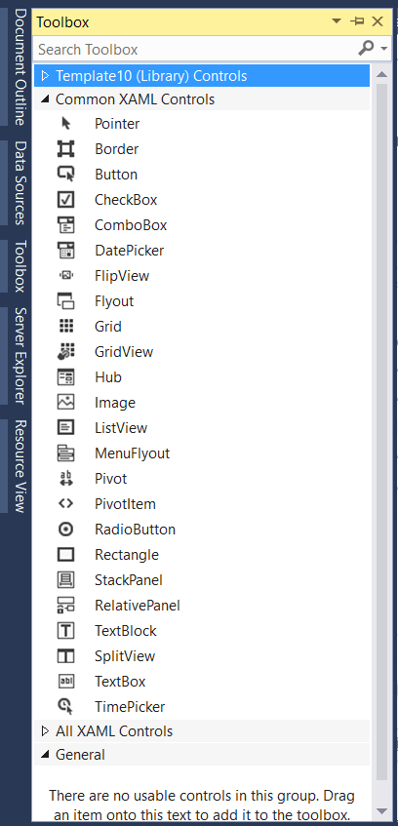
XAML controls
Out of the box toolbox
Inherit from Control / ContentControl
Sometimes FrameworkElement
Custom user controls
Inherit from UserControl
Custom templated controls
Inherit from Control / ContentControl

Slide 7
What's in a control?
Object
DependencyObject
UIElement
FrameworkElement
Control
ContentControl
ButtonBase
Button
Relevant properties
FrameworkElement.Style
FrameworkElement.DefaultStyleKey
FrameworkElement.Resources
Control.Template

Slide 8
Control definition
Button
Class
Button
Template
Windows.Foundation. UniversalApiContract.winmd
Generic.xaml Compiled Package Resource Index (PRI)
Notes:
PACKAGE RESOURCE INDEX

Slide 9
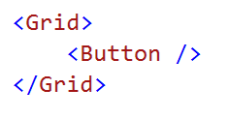
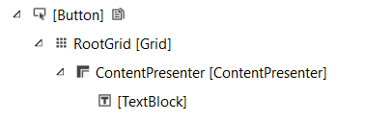
Control's Visual tree versus Logical tree

Slide 10
Looking at the visual tree

Slide 11
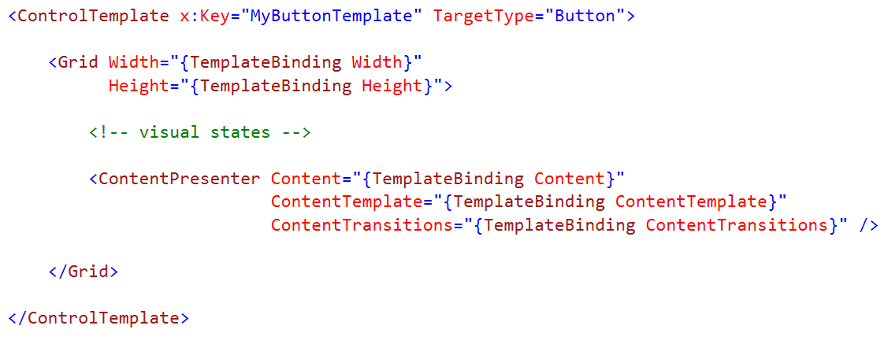
Control template

Slide 12
How to bind inside a content template
Content="{Binding Path=Content, Mode=TwoWay,
RelativeSource={RelativeSource Mode=TemplatedParent}}"
versus
Content="{TemplateBinding Path=Content} "
versus
Content="{x:Bind Path=Content, Mode=TwoWay} "

Slide 13
Themes\Generic.xaml
Contains default styles
Contains default templates
Gets applied before App/Page/Control
Automatically included / compiled to PRI

Slide 14
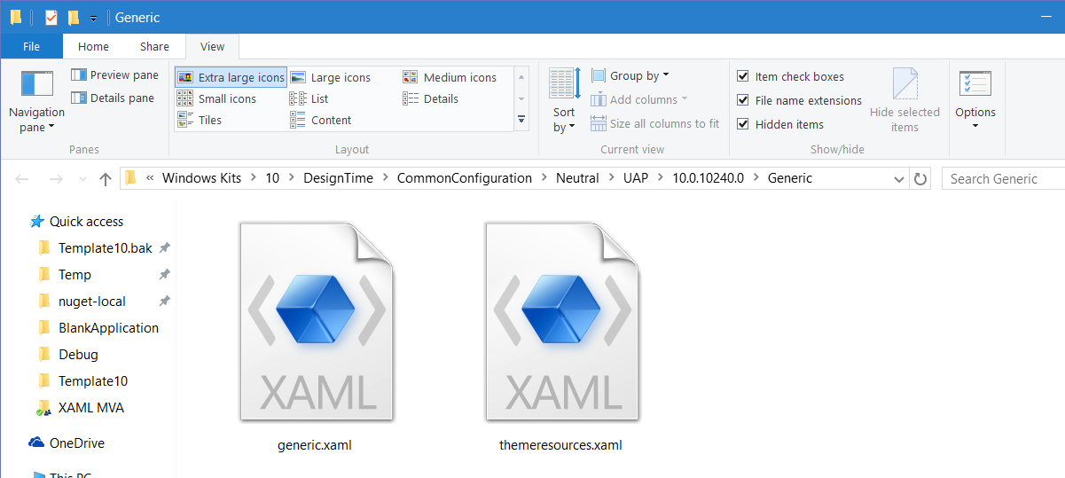
Generic.xaml
C:\Program Files (x86)\Windows Kits\10\DesignTime\ CommonConfiguration\Neutral\UAP\10.0.10240.0\Generic

Slide 15
Re-templating an existing control

Slide 16
Custom control considerations

Slide 17
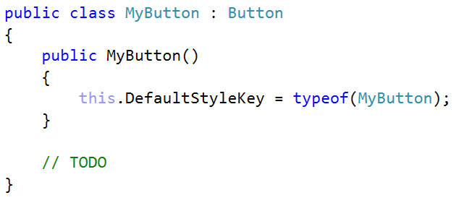
Create a control from another (sub-classing)
Developer need ONLY EXTEND existing control behavior

Slide 18
Sub-classing an existing control

Slide 19
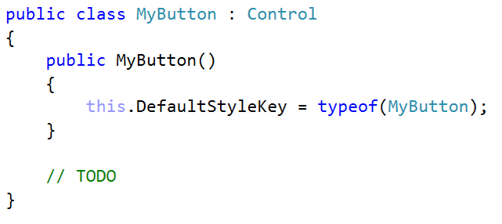
Create a control from scratch
Developer must IMPLEMENT ALL control behavior

Slide 20
Creating a control from scratch

Slide 21
Control versus ContentControl
Control : FrameworkElement
The base for almost all controls, some controls sub-class FrameworkElement
ContentControl : Control
Content property
ContentTemplate property
By default <ContentPresenter />
ContentTransitions property

Slide 22
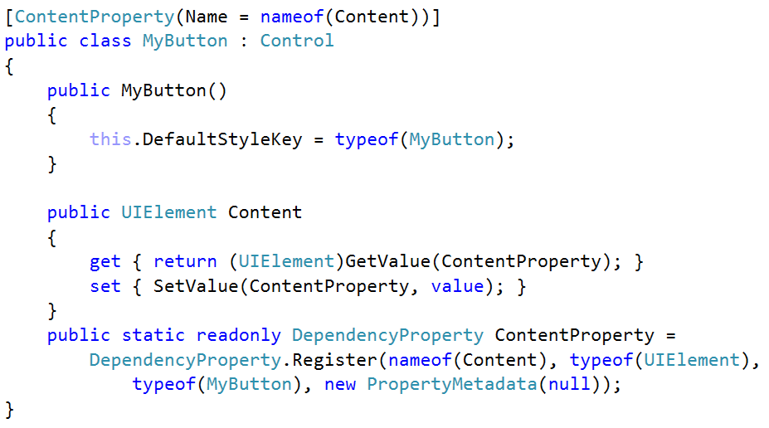
Create your own ContentControl
Next, ContentTemplate and ContentTransitions

Slide 23
Templated control versus User control
Templated control
Slightly better performance
Is not coupled with XAML
Easy to re-template
Design-time support
User control
Composite control
Is coupled with XAML
Cannot re-template
Design-time support
A user control encapsulates a unique composite of XAML

Slide 24
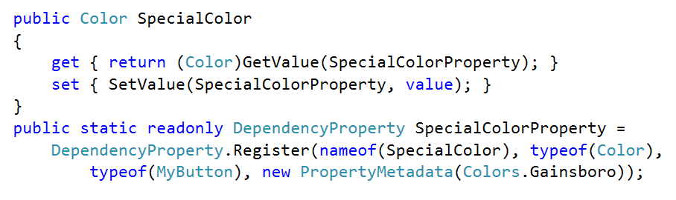
Custom properties
Dependency properties enable binding, animations, and setters

Slide 25
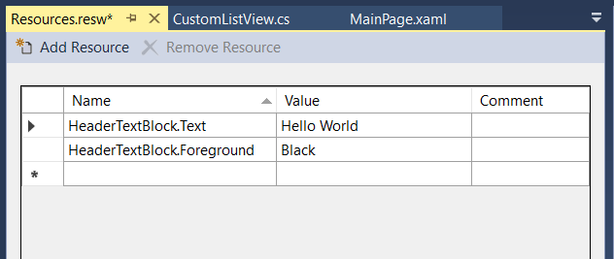
Handling localization
<TextBlock x:Uid="HeaderTextBlock" />
Developers should expose nested localization properties as control properties.

Slide 26
Custom events
Routed event
Bubble : Where the event instance routes upwards, from source element to root.
Tunnel : Where the event instance routes downwards, from root to source element.
Custom events
Create custom events or custom-bubble events
public event EventHandler<EventArgs> Checked
public event EventHandler<RoutedEventArgs> Checked
Only the WinRT platform can create Routed Events

Slide 27
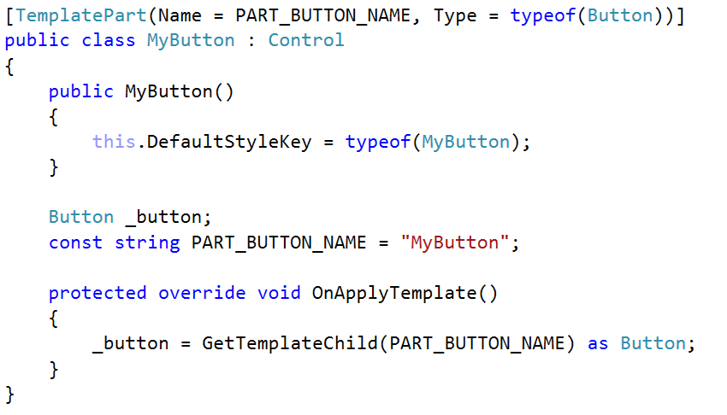
Accessing controls
FYI: Blend does not implement [TemplatePart] for WinRT

Slide 28
Handling visual focus
Control.UseSystemFocusVisuals=True
Automatically draws a focus rectangle (1px dotted line) around the bounding box of your control.
Control.IsTemplateFocusTarget=True
Change the default behavior, instructing the system to a specific part in your template where the box should draw.
VisualStateManager.GoToState(FocusedVisualState)
Opt-out of the native focus functionality for a custom experience. This puts all the burden on the developer.

Slide 29
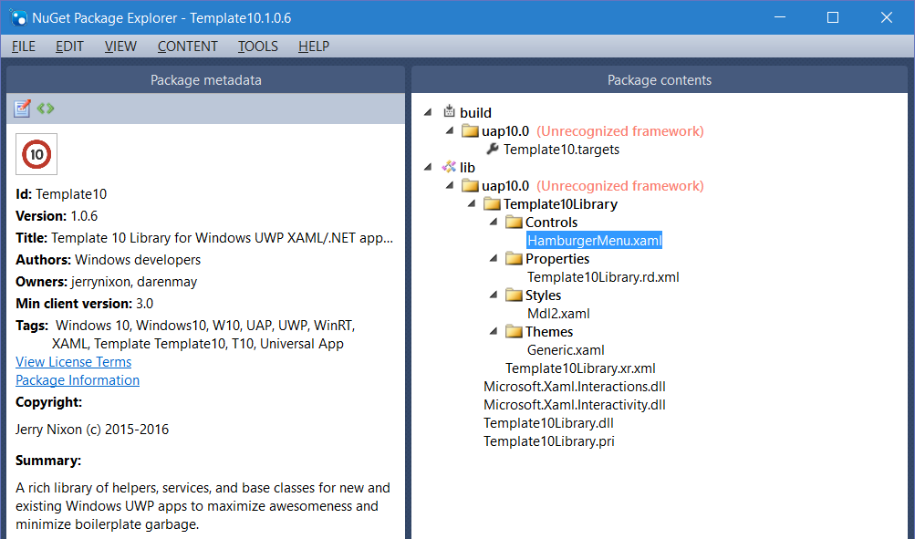
Packaging your controls

Slide 30
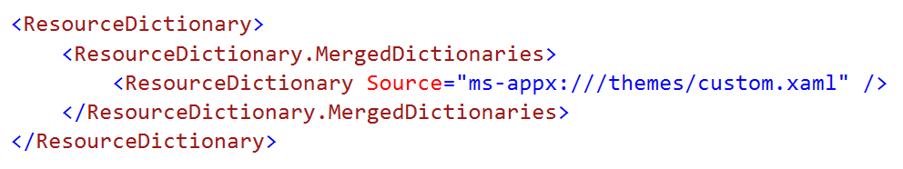
Merging dictionaries in a remote generic.xaml?
Remember to fully-qualify your paths.

Slide 31
Summary
Control fundamentals
Custom control considerations

